Slide 1
Emotion Recognition with Machine Learning
Loop Q Prize –challenge
Teemu Sormunen
github.com/TeemuSo/Loop-Q-prize.git

Slide 2
Approch to competition & goals
“Extra attention to code quality was paid in re-usable src package. It was used as a util-package that could be re-used in notebooks with ease. Jupyter notebook quality might not be best possible as it was for exploration and exploitation, and modified multiple times.”
Data science project
–best practises
I attempted to keep the project structure clear, use modular structure and keep the scalability possibilities open. I used cookiecutter’s datascience project template (https://drivendata.github.io/cookiecutter-data-science/).
Emotion recognition knowledge
The aim for this challenge for me was to get acquainted with emotion recognition research, and to solve a real world problem. Multiple research papers on merging emotions and technology was read.
Theoretical foundations
One goal was also to apply as many theories I’ve learned during the university studies so far. I tried to reason about everything that I did, and understand the causality between models, data, and results.
Training resources
Training was done with RTX 2060 locally and with Google Colab.
Initially, data flow was from Google Drive to Colab, but after training was done, the data was moved to AWS.

Slide 3
Emotion recognition
In general
The traditional view is that emotions can be read from facial expression. This however assumes that person naively expresses his/hers emotions, and that the culture where emotions have been developed is known.
This view is challenged in research paper¹ and is often discussed widely. One must be careful to state whether a machine is able to read emotions, or give probabilistic predictions on stationary images.
Why is it a problem?
Assigning true emotion from facial expression is hard. Assigning it based on a image without context is even harder. We can learn to assign certain facial muscle movements to certain emotions by having prior knowledge about the culture and learned behaviours by using maximum likelihood.
Figuring the true emotion behind the facial expression is much more challenging problem. It requires context. In order to truly assign emotion to a situation, we would not only need the previous event but also other events where similar emotions might arise, and interpolate based on that knowledge.
For this contest we simply treat the emotion recognition as image classification, and forget about the practical applications and philosphy.
¹https://www.ncbi.nlm.nih.gov/pmc/articles/PMC6640856/, https://www.youtube.com/watch?v=5LTPu_g1KC0

Slide 4
The data and approach
Dataset
The underlying dataset turned out to be FER2013¹ most likely after just a little bit of research. This was also one of the reasons why I decided not to use all time trying to achieve high scores, as one could simply copy approaches from elsewhere and scale them up.
The dataset¹ was collected through Google image search, and labels were corrected by human labelers.
Previous research
Current state-of-art for emotion recognition^{2,3,4} on stationary images have been achieved with deep learning models and their ensembles.
Choice of algorithms
The goal was to experiment algorithms from wide range of area. For algorithms which didn’t form meaningful image embeddings implicitly, explicit embedding was calculated by different methods.
The attempt to achieve state-of-art would turn to computational challenge rather than machine learning, so I decided to try to cover the data from wide range of different perspectives.
¹https://arxiv.org/pdf/1307.0414v1.pdf
²http://cs230.stanford.edu/projects_winter_2020/reports/32610274.pdf
³https://arxiv.org/ftp/arxiv/papers/2105/2105.03588.pdf
⁴https://arxiv.org/pdf/2103.10189v1.pdf

Slide 5
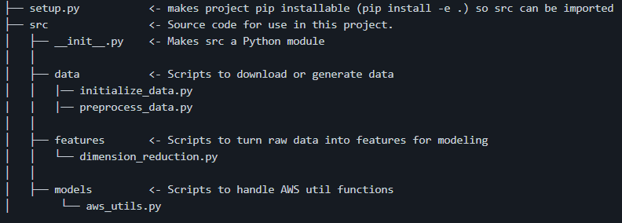
Utility package
Package for helper functions
During the project I paid extra attention for developing all helper functions to centralized package. This package is imported in different notebooks, and this structure is useful when scaling the application.

Slide 6
AWS storage
Folder structure
Model and data storage:
Data and models are stored in AWS S3 bucket. When initializing the project, all models are loaded to models/ -folder which is gitignored.
Storage permissions
User has permission to read data from bucket ’loopqprize’. Folder structure in the bucket can be seen at bottom of the screen.
NOTE: The credentials should be stored in ~/.aws/ folder, following the AWS naming-standard.
loopqprize/
data/
0.npy
…
models/
cnn_features/
model.joblib
hog_features/
model.joblib pca_features/
model.joblib
pytorch_model.pt
Example
~/.aws/credentials
[default]
aws_access_key_id=EXAMPLE
aws_secret_access_key=EXAMPLE
~/.aws/config
[default]
region=eu-north-1

Slide 7
Data flow
During repository initialization:
load models from AWS to local storage.
create embeddings from images with CNN (6GB).
If GPU isn’t accessible, I can provide the weights. Myself, I’m using WSL and had problems with CUDA.
After model initialization:
User can re-train model, models are saved to local storage.
Data is loaded from AWS on-demand.
AWS S3 bucket
Optional
data
Evaluation notebooks
Re-train/save models
models
Local storage
Create cnn embeddings

Slide 8
Notes on initialization
Repository initialization has been done using WSL and pyenv-virtualenv combination.
Tested Python version is 3.6.10
Conda hasn’t been tested, although in principle it should be working
The initialization was tested on two separate computers, although I can’t guarantee that it will work out straightforwardly without problems. For example I won’t be touching ~/.bashrc, as I think user should be in control of it.

Slide 9
Data exploration
1
A closer look at the data

Slide 10
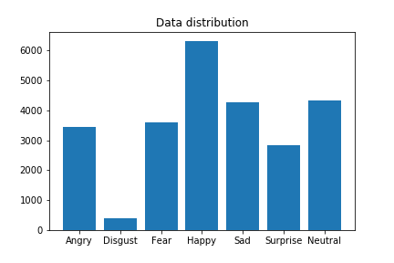
Data distribution
Data is heavily imbalanced
This can be taken in to account in two ways:
Using class weights to weight the class frequency classes more highly
Synthesizing images, in example with SMOTE

Slide 11
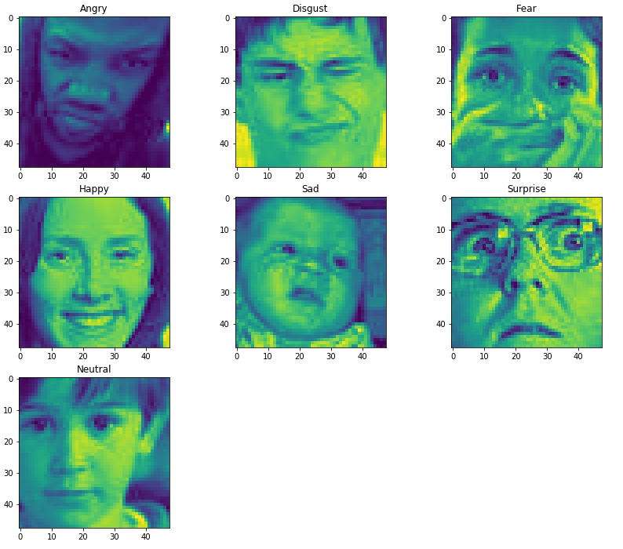
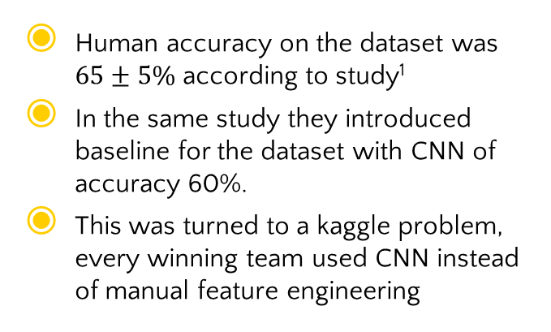
Data distribution
Human accuracy on the dataset was $65±5\%$ according to study¹
In the same study they introduced baseline for the dataset with CNN of accuracy 60%.
This was turned to a kaggle problem, every winning team used CNN instead of manual feature engineering
¹https://arxiv.org/pdf/1307.0414v1.pdf

Slide 12
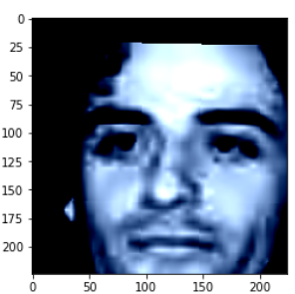
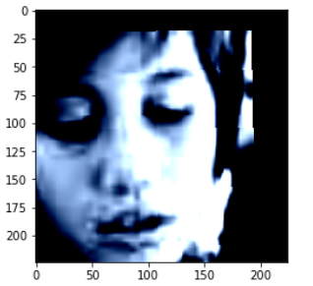
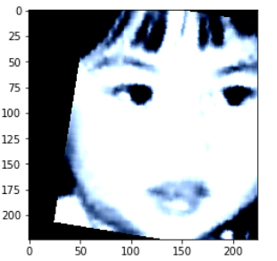
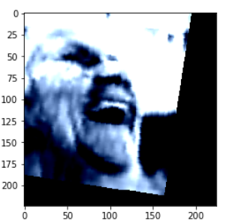
Data augmentation
Data was augmented for ResNet with 10 degrees random rotation, random affine transformation in X-Y direction by 20%, and randomly flipping the image horizontally.
Example augmentations can be seen on the right
Data was also upsampled to input size 224x224 for the pretrained ResNet.

Slide 13
Model exploration
2

Slide 14
Model groups explored
2
With dimensionality reduction
Deep Learning
Supervised algorithms
Unsupervised algorithms

Slide 15
Deep Learning
2
Inception V3
InceptionV3 was chosen as it has achieved high scores in other emotion recognition challenges. It was found to be difficult to fit to good results however.
CLIP
(connecting text and images)
CLIP was taken as experimental model. It’s large and requires substantial amount of resource for fine tuning. Fine tuning was attempted for a long time, but it failed to converge so it was discarded.
ResNet-50
ResNet-50 is quite lightweight model with 23 million parameters, and it was used as the model to be evaluated.
____________________
Not chosen for the final evaluation
____________________
Not chosen for the final evaluation
____________________
Chosen for the evaluation

Slide 16
Dimensionality reduction
2
Principal component analysis
PCA usage was inspired by an old work ‘Eigenface’. Input dimensions can be greatly reduced by using the features which provide the largest variance in the dataset.
Histogram of oriented Gradients
Histogram of Gradients efficient algorithm from pre-deep-learning –era. It was chosen to represent the images in lower dimensional space, while retaining invariance to geometric and illumination changes.
EfficientNet-b0
Convolutional networks are thought to have meaningful feature representations when takes from final convolutional layers. EfficientNet aws chosen as it has less parameters than other state-of-art models.
It generates 1280x7x7 embeddings. This high dimensional embedding was further reduced with PCA to 200 components, to keep computational load bearable.

Slide 17
Supervised Algorithms
2
Logistic Regression
Logistic regression was used due to its speed and relatively good performance.
XGBoost
XGBoost was tested out of curiosity, as it has been found to produce great results in other domains.
Support Vector Machines
Support vector machines were tried as they are flexible and interpretable substitutions for deep networks. They have heavy mathematical background, and for this reason they were chosen to be one of the models.

Slide 18
Unsupervised Algorithms
2
K-Nearest Neighbors
K-Nearest Neighbors is often a nice starting point. In this case it was used to be the ‘lightweight and fast algorithm’ for calculation. In practise it turned out to be not so efficient, but was kept for comparison.

Slide 19
Performance evaluation
3

Slide 20
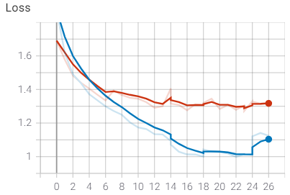
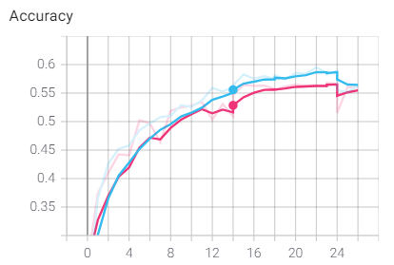
ResNet-50 training metrics
3
Validation loss diverged slightly during training, validation curve is one that performs worse on both figures.
Training was done with Adam with default learning rate 0.001
On epoch 14, when validation loss started plateauing, optimizer was switched to SGD with learning rate 0.001 and momentum 0.9. We see that accuracy and loss improved slightly after the switch
I tried to further optimise hyperparameter, but performance only dropped

Slide 21
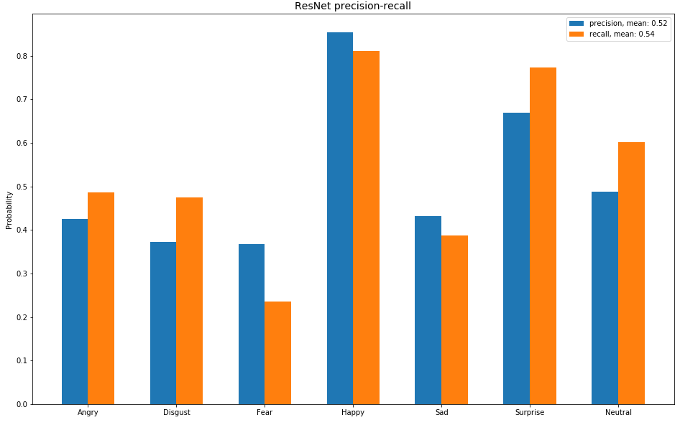
ResNet-50 prediction metrics
3
Precision and recall were mostly balanced

Slide 22
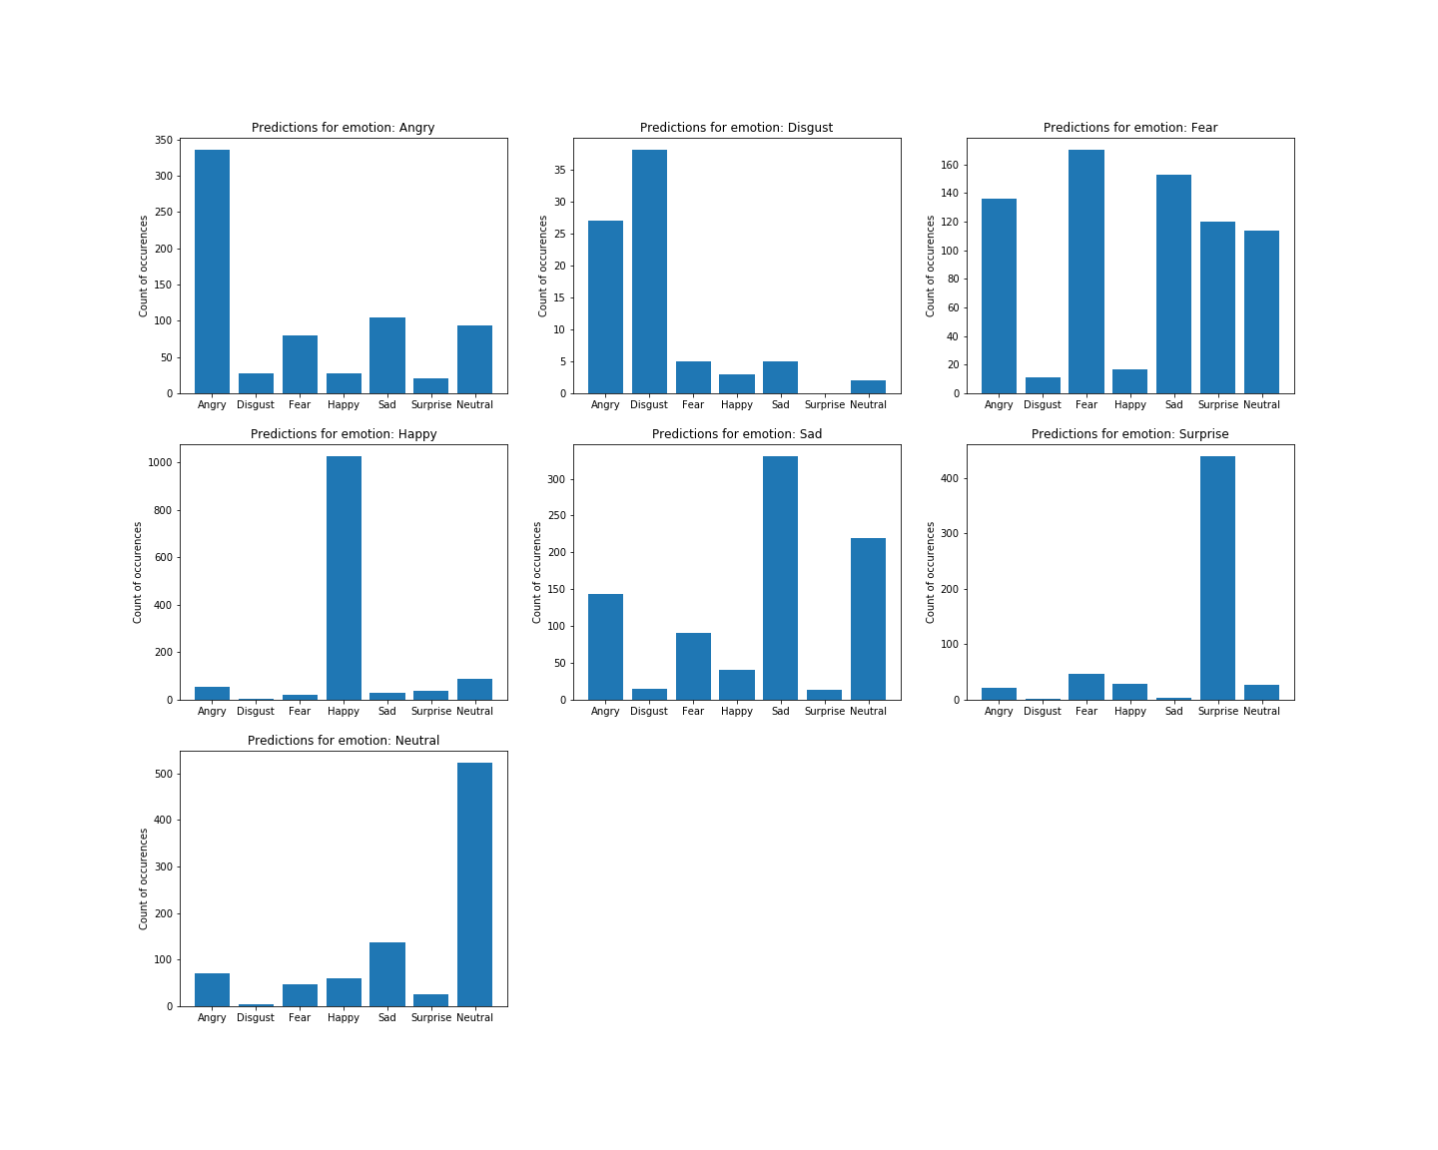
Resnet-50: What emotions mix easily?
3
Classes that have similar facial expressions tend to mix easily. Especially fear seems to be easily mixed with multiple classes
Other classes seem to be separable quite nicely

Slide 23

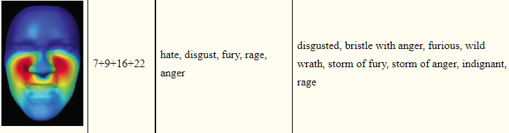

Facial Action Coding System (FACS)
3
FACS is a system designed to identify facial movements with respect to certain areas. In the image below, we see what facial Action Units (AU) are activated on anger-expression.
If we would start to fine tune and explain our model, a very good starting point would be to identify whether our model learns the Aus well, or whether its classifying based on different regions in the images.
Facial muscle activation of infant when angry using reverse correlation
Emotional Expressions Reconsidered: Challenges to Inferring Emotion From Human Facial Movements, https://www.ncbi.nlm.nih.gov/pmc/articles/PMC6640856/
Example of facial Action Unit 9
Emotional Expressions Reconsidered: Challenges to Inferring Emotion From Human Facial Movements, https://www.ncbi.nlm.nih.gov/pmc/articles/PMC6640856/

Slide 24
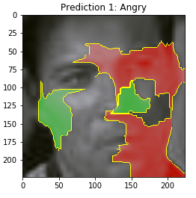
ResNet-50: Important areas in images
3
On the left we see our models prediction for anger.
Green area = positively affecting our prediction towards anger
Red area = negatively affecting our prediction towards anger
On the right we see culturally common expression for anger
Red area = high muscular activation, many action units (AU)
Blue area = low muscular activation, low AU
Facial muscle activation of infant when angry using reverse correlation
Emotional Expressions Reconsidered: Challenges to Inferring Emotion From Human Facial Movements, https://www.ncbi.nlm.nih.gov/pmc/articles/PMC6640856/

Slide 25
ResNet-50: Important areas in images
3
Sample taken here is a random sample taken from start of the test_loader. By inspecting other samples by eye, the network seems to pay particularly much attentiont to area around nose in our predictions.
Going through network predictions would be a research on its own, and it would be interesting to reflect on what our network learns, based on the current studies and knowledge about facial muscle activation patterns.
Facial muscle activation of infant when angry using reverse correlation
Emotional Expressions Reconsidered: Challenges to Inferring Emotion From Human Facial Movements, https://www.ncbi.nlm.nih.gov/pmc/articles/PMC6640856/

Slide 26
Traditional methods: Class imbalance handling
3
Class imbalances were tried to solve with balancing the class weight inversely proportionally to class frequencies
Other approach was to use SMOTE by synthesizing data to be balanced. This approach slightly reduced the performance, and it was discarded
Cross validation was used in conjunction with hyper-parameter optimization with sklearn.HalvingGridSearchCV

Slide 27
Traditional methods: Hyperparameter search
3
Hyperparameters were searched for all of the models
Hyperparameter optimization was done with sklearn experimental HalvingGridSearchCV
Uses successive halving strategy, which basically means that it terminates the candidates which aren’t performing well. This speeds up the parameter search greatly.

Slide 28
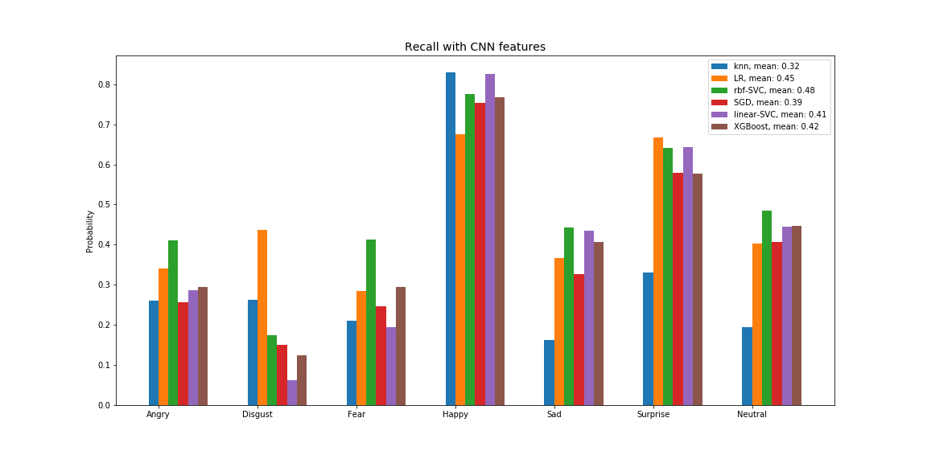
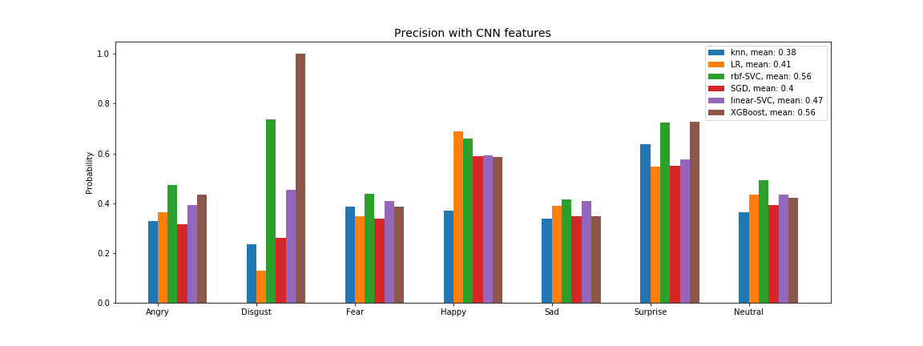
Traditional methods: CNN embeddings
3
Recalls are slightly worse than precision. CNN embeddings had 200 features, that were filtered from the original high-dimensional embeddings.
Here RBF-kernel SVM achieves surprisingly high precision, as matches the neural network precision.

Slide 29
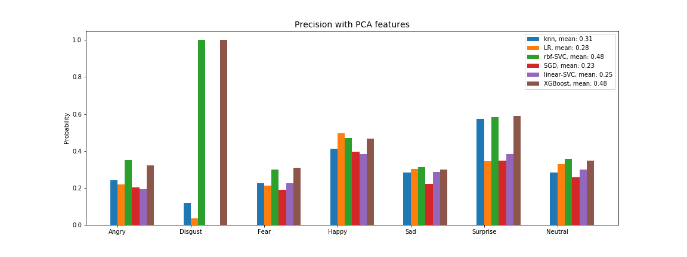
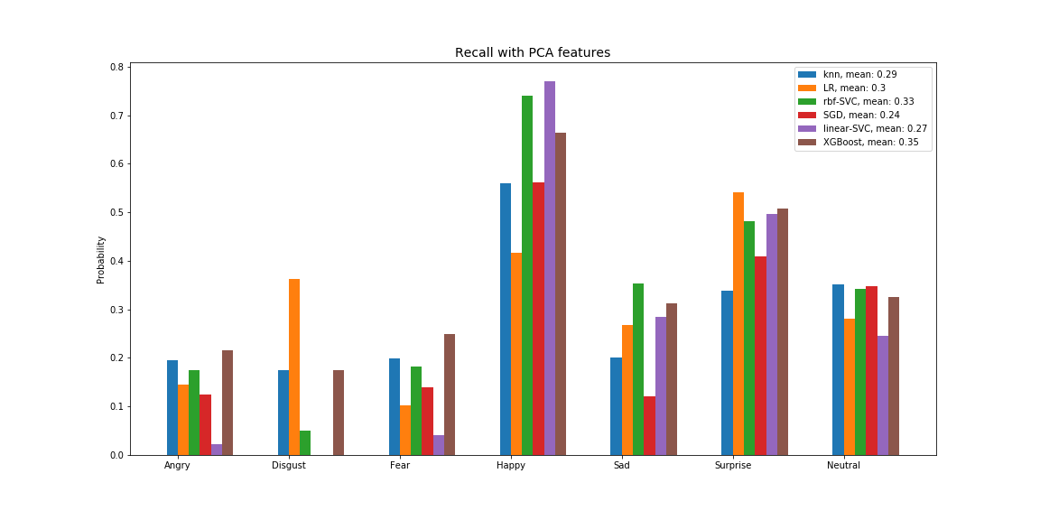
Traditional methods: PCA embeddings
3
RBF-SVM and XGBoostseem to classify disgust rarely, but always classificy it right – in other words it has high precision but low recall

Slide 30
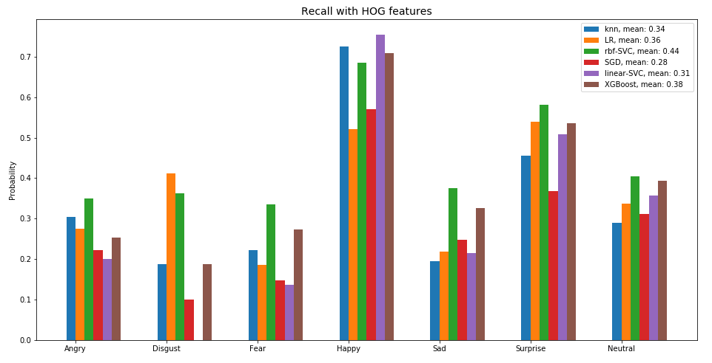
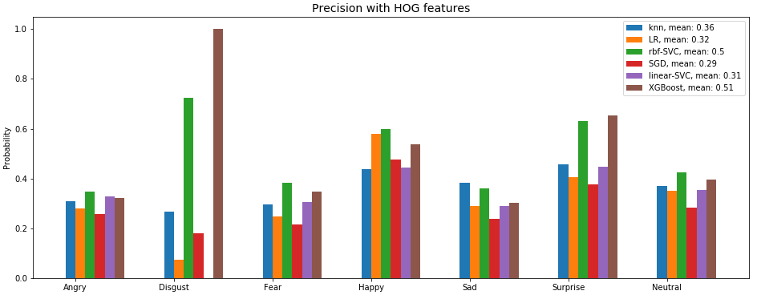
Traditional methods: HOG embeddings
3
Precision and recall are the easiest metrics to interpret. Here we see that easiest recall was happiness.
Comparison of algorithms is difficult with precision-recall, if there’s no big differences.

Slide 31
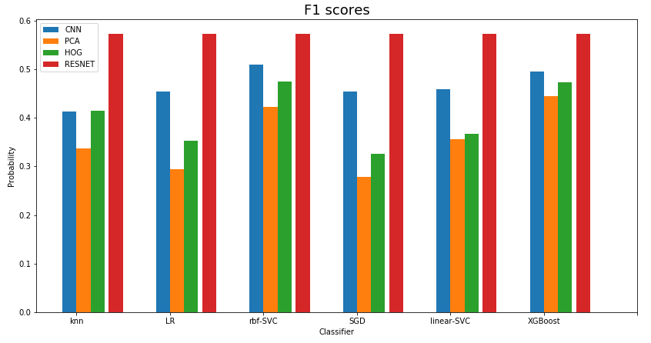
F1-scores
3
F1-score is a concise way to describe precision-recall tradeoff. It turned, that CNN embeddings are the best ones while HOG is strong second
This was not really a surprise, as CNN’s are known to be excellent feature extractors. Interesting continuation would be to produce embedding from larger EfficientNet, for example EfficientNet-v7.
Best results are provided with ResNet which is also not surprise.

Slide 32
Ensembles
3
Majority voting ensemble was tried to see, if the majority of classifiers would be more confident than individual
Standalone ResNet classifier achieves 57% F1-score, while majority voting ensemble with ResNet in it has 56% F1-score
This suggests that classifier confidence probability should be taken in to account in predictions. This will be left for future work.
Conclusion: I decided to finally train ResNet-50 with full data, against my initial thought. I ended up with this decision, as it will be end-to-end pipeline which is easy to configure. Using CNN embeddings would result in difficult-to-construct pipeline, as we would need the CNN encoder, and SVM as the classifier.

Slide 33
Results
4

Slide 34
Final training
4
Final training was performed by fine-tuning model with SGD with learning rate of 0.0001, momentum 0.9 and a small batch_size of 8
Model was evaluated on validation data periodically.
During previous training attempts, it was seen that loss could reach around ~0.9 while accuracy was around 58%. I figured that the model wouldn’t fit on test data, as long as it didn’t perform absurdly good on the test data, and loss wouldn’t go radically lower than 0.9
In a sense, our validation set was used for choosing hyperparameters, and also for validating our final training results. It could be, that too much depends on validation set choice, but I don’t see it in this case.
Finally, fine tuning for few epochs was done on validation data also, to get the last squeeze out of the initial data distribution that was given.

Slide 35
Limits of the model and data
4
By inspecting the model predictive distribution, it seems like it follows the original data distribution quite much. This model would be effective for detecting happiness and surprise, as it has over 70% recall and precision on those.
The challenge addressed detecting ”difficult feelings”, such as fear and disgust. These emotions are by far the most challenging to detect with machine, although they are often easy to interpret from real-life situations, when we have the context. Here comes the context-problem. For reliable emotion classification, we need to know the context.
Precision-recall before the final fine tuning

Slide 36
Model scalability
4
Model and data are stored in AWS S3, so the scalability of the solution would be relatively straightforward. We would only need to store the additional data to S3, where we can pipeline the data easily to AWS SageMaker where model can be trained.
IF we would have continue with hand-made features, then we could save those features in SageMaker Feature Store, and re-use them later.
IF we would need to create API for the model, we could also use the AWS inner CI/CD pipelines easily.

Slide 37
Future considerations
5

Slide 38
Prediction pipeline
5
If we were to deploy an image recognition solution, we would need to consider the prediction pipeline. For RBF-SVM with CNN embeddings, we would need first the encoder-CNN and then RBF-SVM in the pipeline. This requires unnecessary work, as we could just approximate the RBF-SVM with deep learning solution, as RBF-SVM doesn’t provide any transparency in the process due to ”un-interpretable” embeddings.
Deep learning end-to-end solution is indeed attractive, and for this case it probably would be the choice to go. The input is fed as images, so it is also easy to interpret input/output relation. The model is still quite a black box, but we have tools for explaining the images via approximation techniques. In a sense, we are able to understand the underlying complex function by approximating it with more simple classifier for single images.

Slide 39
Future considerations
5
Emotion recognition is a great challenge to be tackled. I think it should not be underestimated. Machine learning practitioners must be aware of larger consequences, whenever they get state-of-art results on certain domain.
Data analysis on image dataset can, and should be done and high accuracies should be attempted to achieve. Machine learning solutions however are always in the end trying to find a solution for a real world problem, let it be emotion recognition for customer service, for the court or for the autonomous driving. The possibilities are endless.
But this can not be solved only by increasing model complexity and scaling data. We need to first understand ourselves how emotions are generated, and then we need to open the black box which we think “understands” emotions. After all, it’s only an observation machine which learns to generalize based on what we teach for it. For some domain application, learning to recognize emotion based on certain facial muscular activity might be enough. But we must make it very clear when that is enough, and when we actually need to find the underlying cause that causes the emotional response.

Slide 40
Self-reflection
5
I think I managed to cover the areas I wanted in the challenge. On the other hand, I wonder if I should’ve focused on deep learning, and start hyperparameter tuning from the start to achieve higher metrics.
Many different things were experimented that was left out of documentation, either due to failure or due to lack of free-time to focus on this project. This area definately has a lot to uncover, and it could even be possible to do another ”sprint” of this challenge, to dive deeper to certain domain of emotion recognition. Maybe one of the most interesting areas would be explainability and applications, as there you simply can’t approach the challenge from statistical point of view.

Slide 41
Notes for organizers
5
Thank you for the competition! It was a great learning opportunity, and my first larger-scale project which I got to organize fully on my own. Few notes regarding the competition and scoring which I thought during the competition
> Dataset is public, therefore solutions are also public. If evaluation metrics would simply rely on accuracy, it’s quite likely that someone would simply download weights of a pretrained model on the task (found online) and find high accuracy.
> This scope of a project was perfectly fit, at least in my own opinion. In the future maybe it would be good for this competition to host some real-world dataset, where innovative solution would be more important. I feel like otherwise the competition might become just a battle for who has the greatest computation resources provided by the university. I found great struggles trying to optimize the computation capacity, but on the other hand that’s part of the learning experience.
> Once more, thank you for the great competition, and especially for the great support you had during it! No matter what I asked via e-mail, I got very informative response.

Slide 42
Loop Q Prize -challenge
Teemu Sormunen
Student at Aalto University
Teemu.t.sormunen@aalto.fi

